Slide 1
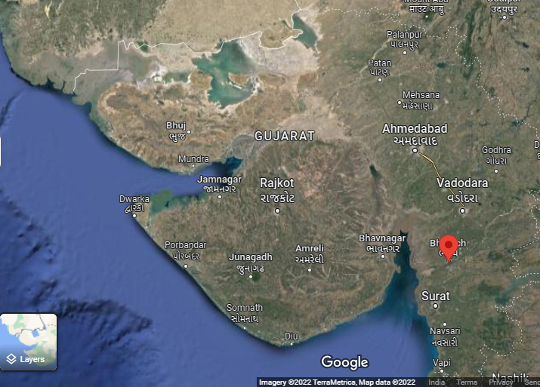

Slide 2
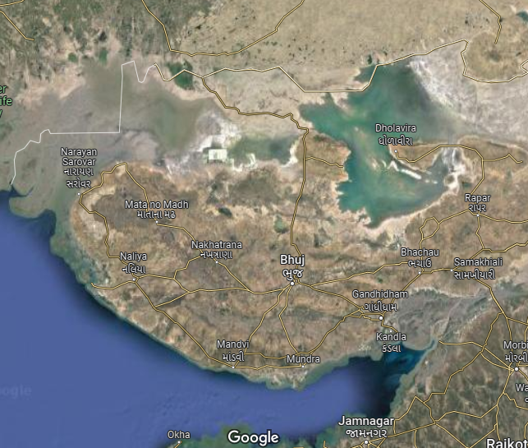

Slide 3
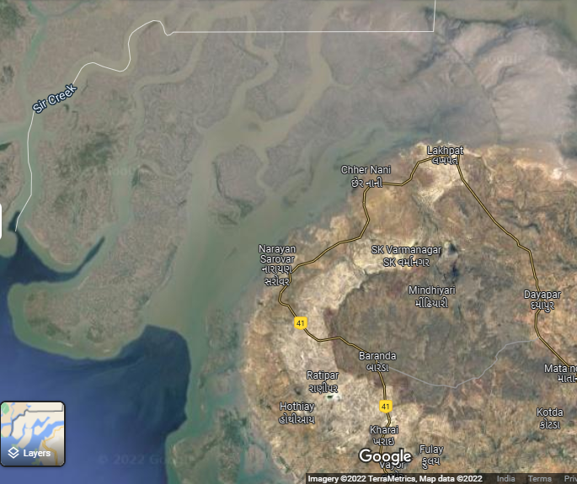
X
Cameras
IB
Inspection Bungalow (Main building)
C
B
A
Connection to IB (Main building)
Coverage line
IB

Slide 4
X
Cameras
IB
Inspection Bungalow (Main building)
C
B
A
Connection to IB (Main building)
Coverage line
IB
Living things

Slide 5
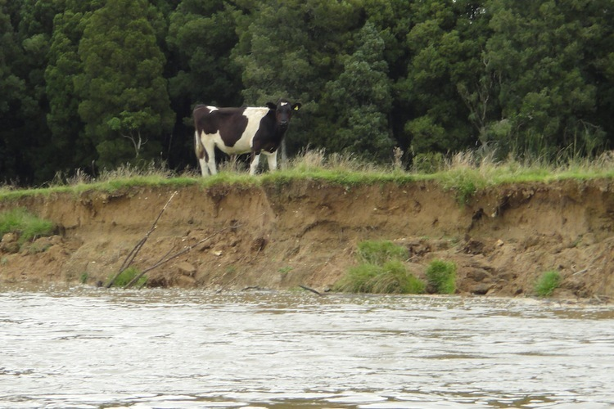
84%
597.11 foot

Slide 6
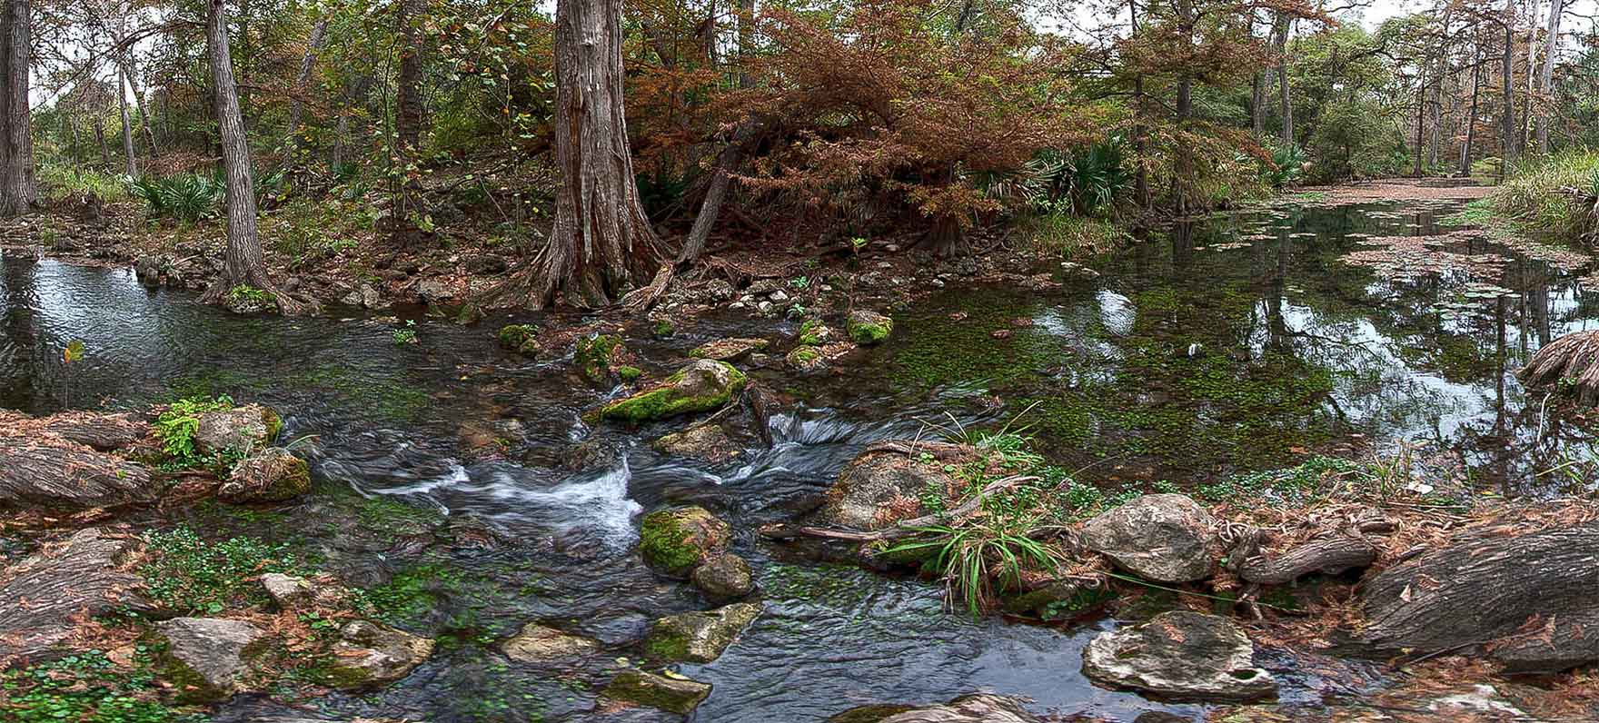
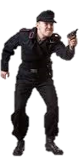
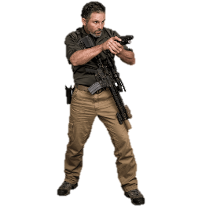
79%
82%
476.45 foot
467.12 foot

Slide 7
